Slide 1

Insurance Risk Prediction: Leveraging Graph Neural Networks with Flask Deployment
By Shoaib Shaikh
Department of Computer Science, University of XYZ

Slide 2
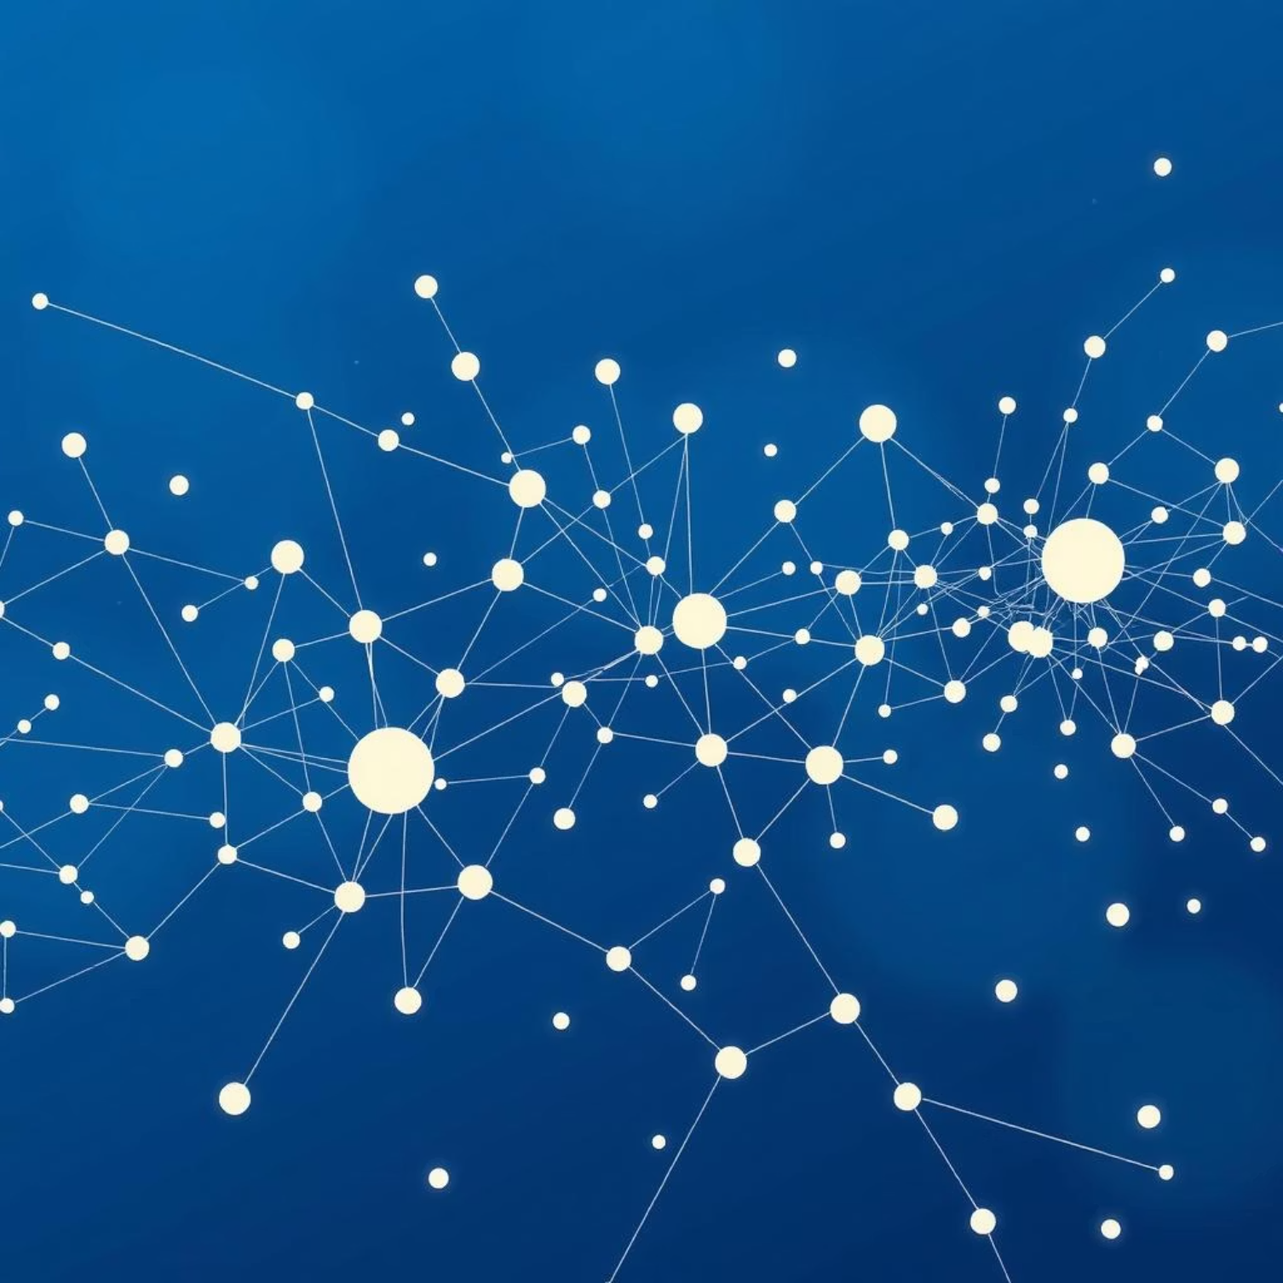
Navigating the Complexities of Insurance Data
Insurance data is inherently complex, characterized by vast amounts of information including policy details, claim histories, and customer demographics. Traditional machine learning models often struggle with this complexity, particularly in identifying intricate patterns and relationships.
These models typically treat data points as independent entities, failing to capture the rich interconnections that exist between policies, claims, and individuals. This limitation can lead to suboptimal predictions for risk assessment and fraud detection.
To overcome these challenges, a new paradigm is required, one capable of understanding and leveraging the relational structure within the data.

Slide 3
Why Graph Neural Networks?
Capturing Relationships
Enhanced Feature Learning
Unlike traditional methods, GNNs excel at modeling relationships and dependencies within connected data, such as social networks or transaction graphs.
GNNs learn rich, meaningful representations by aggregating information from neighboring nodes, leading to more discriminative features.
Improved Prediction Accuracy
Scalability & Adaptability
By considering the graph structure, GNNs can uncover subtle patterns indicative of risk or fraudulent behavior, boosting predictive performance.
Modern GNN frameworks are designed to handle large-scale datasets, adapting well to the dynamic nature of insurance information.
Graph Neural Networks provide a powerful solution for unlocking deeper insights from interconnected insurance data.

Slide 4
Project Objectives
Design GNN Model
1
To develop a robust Graph Neural Network model specifically tailored for insurance risk and fraud prediction.
Graph Data Preprocessing
2
To effectively preprocess raw insurance data, transforming it into a structured graph format suitable for GNN input.
Model Training & Evaluation
3
To rigorously train and evaluate the GNN model using standard metrics, demonstrating its predictive superiority over baselines.
Flask Web Application Deployment
4
To deploy the trained model as an intuitive web application using Flask, ensuring ease of use and accessibility for stakeholders.
These objectives form the foundation of our innovative approach to insurance analytics.

Slide 5
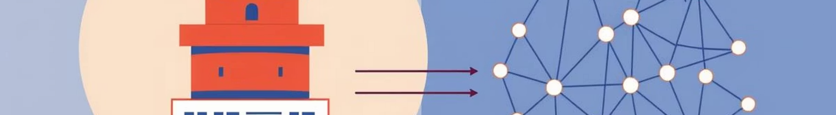
Bridging the Gap: GNN vs. Traditional ML
Traditional Machine Learning
Commonly used: Random Forest, Logistic Regression, XGBoost.
Treats data points independently, ignoring their relationships.
Effective for tabular data, but limited in capturing complex networks.
Risk of overlooking crucial relational patterns in insurance data.
Graph Neural Networks
Models data as nodes and edges, representing explicit relationships.
Learns from local neighborhood structures and global graph patterns.
Provides a powerful advantage in fraud detection and complex risk assessment.
Uncovers hidden connections that traditional methods cannot.
The ability to model relationships is the critical differentiator for GNNs in complex domains like insurance.

Slide 6
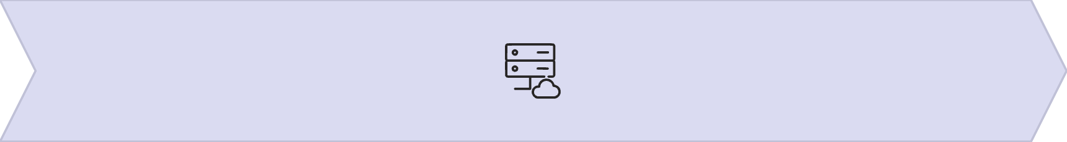
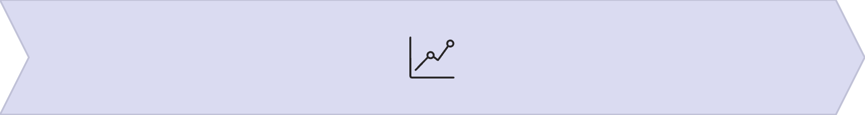
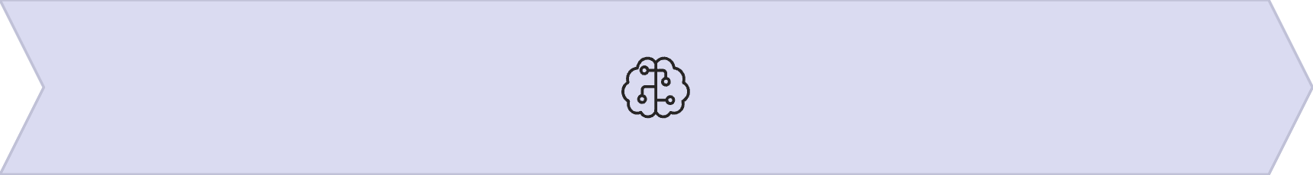
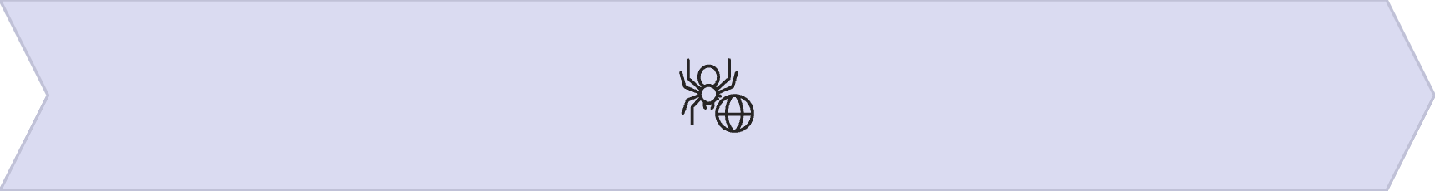
Methodology: A Step-by-Step Approach
Data Collection
Graph Construction
Gathering comprehensive datasets including insurance policies, claim records, and customer profiles.
Transforming raw data into a graph structure with nodes (e.g., customers, policies, claims) and edges (relationships).
GNN Model Training
Flask Deployment
Implementing and training the GNN using PyTorch Geometric to learn intricate patterns for risk prediction.
Developing a user-friendly Flask web application for seamless model interaction and prediction retrieval.
This systematic methodology ensures a robust and deployable risk prediction system.

Slide 7
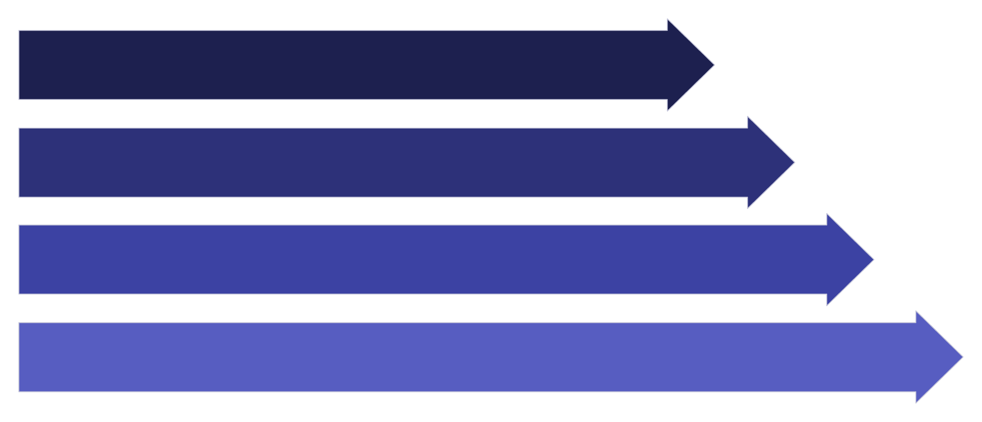
System Architecture & Workflow
Our system operates through a streamlined process, from raw data ingestion to real-time risk prediction via a user-friendly interface.
Raw Data
Preprocessing
Graph Build
GNN Training
This architecture ensures efficient data flow and an accessible prediction interface for end-users.

Slide 8
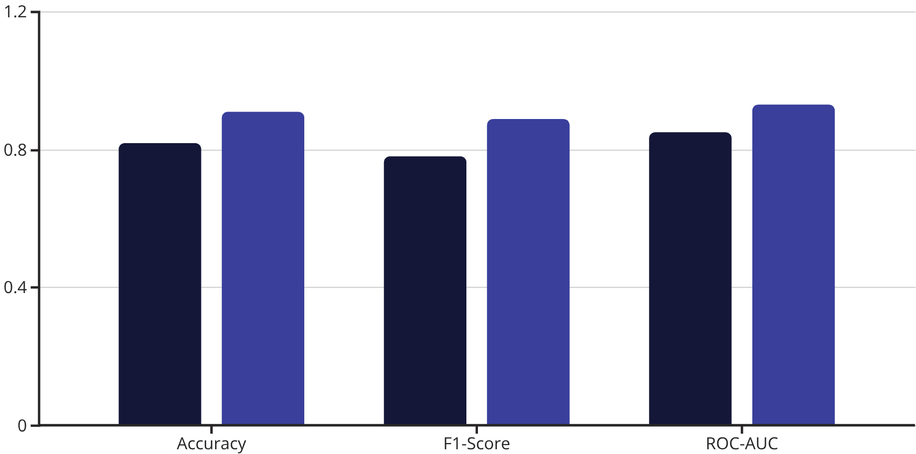
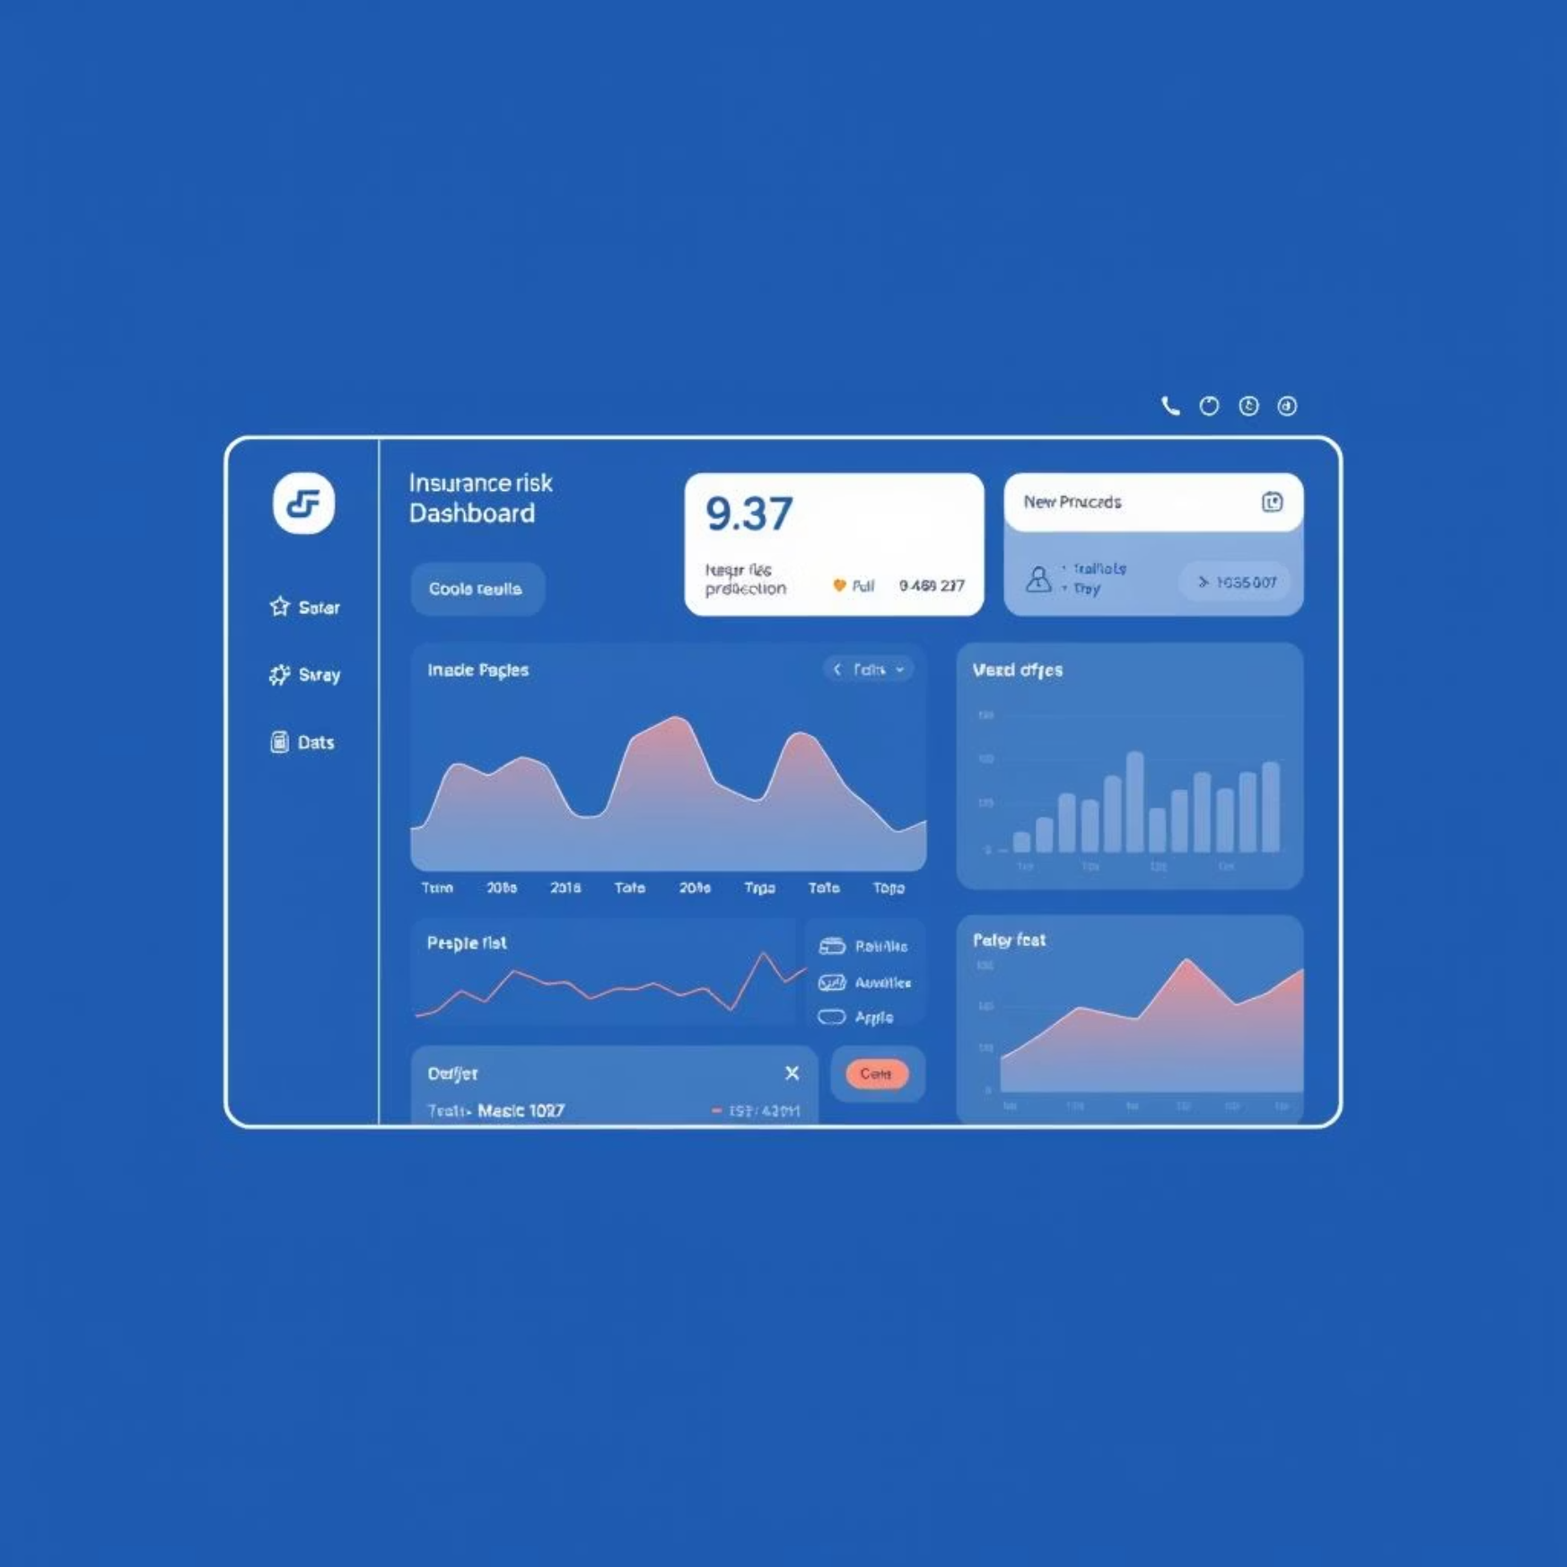
Results & Evaluation: GNN's Superior Performance
Traditional ML
GNN Model
The GNN model consistently outperformed traditional machine learning baselines across key evaluation metrics, demonstrating its ability to leverage relational data effectively.
Interactive Prediction Interface
The Flask web application provides a user-friendly interface for real-time risk predictions, showcasing the model's output in an easily interpretable format.
These results validate the significant advantages of applying GNNs to insurance risk prediction.

Slide 9
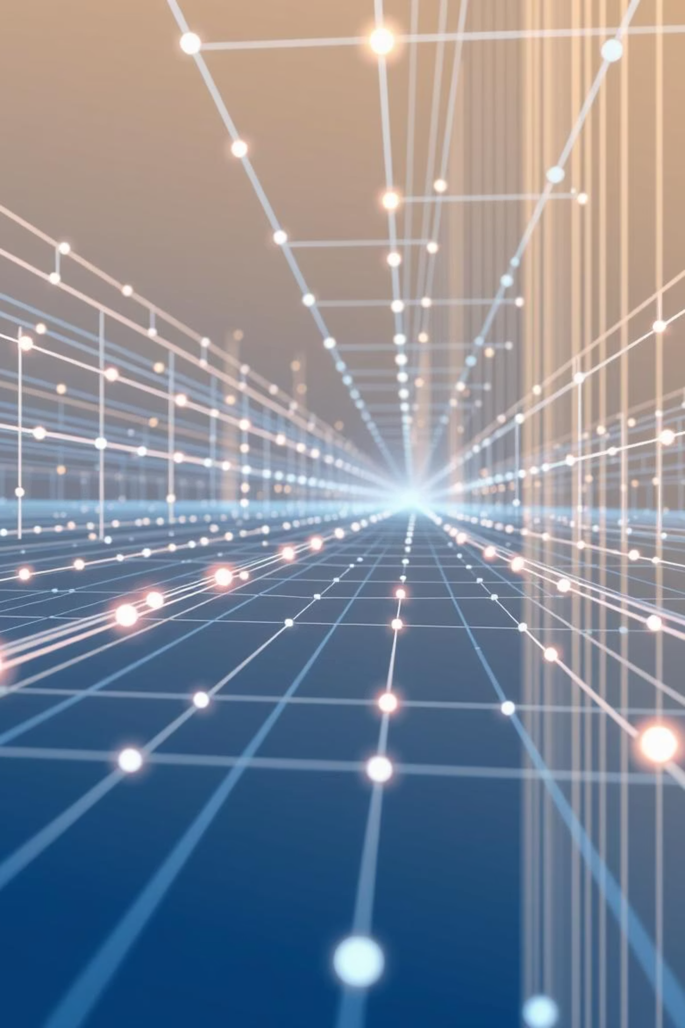
Conclusion & Future Directions
GNN's Impact
Accessibility via Flask
Graph Neural Networks significantly improved prediction accuracy by effectively capturing complex relationships within insurance data.
The Flask deployment made the sophisticated GNN model accessible and practical for real-world application.
Future Enhancements
Integrate diverse external data sources.
Explore larger-scale system architectures.
Develop comprehensive prediction dashboards.
This project lays a strong foundation for advanced, relationship-aware analytics in the insurance industry.

Slide 10
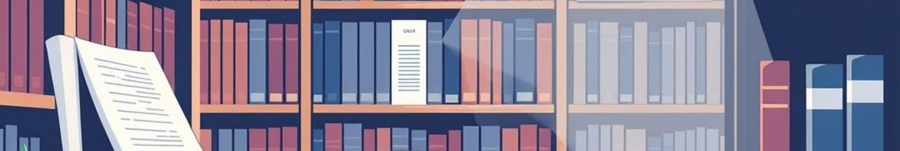
Key References
Our work builds upon foundational research in Graph Neural Networks and modern web development.
Kipf, T. N., & Welling, M. (2016). Semi-supervised classification with graph convolutional networks. arXiv preprint arXiv:1609.02907.
PyTorch Geometric Documentation. Comprehensive resources for GNN implementation.
Flask Documentation. Official guide for Python web framework development.
Additional research papers on insurance fraud detection and risk modeling using advanced machine learning techniques.
Thank You!
Questions & Discussion

